Slide 1


Music Store Data Analysis Project using SQL

Slide 2
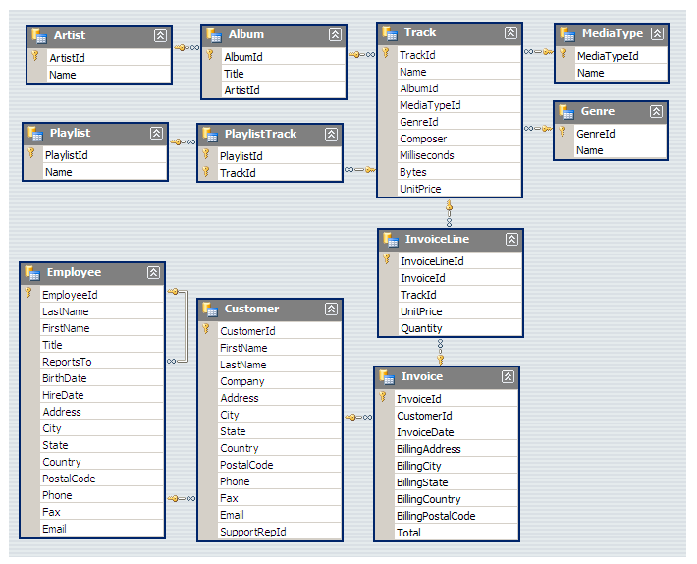
Understanding the dataset:
So, there are a total of 11 tables.
For solving this -I used Joins, aggregate functions, date functions, Order by clause, where clause, limit clause, cast and CTEs

Slide 3


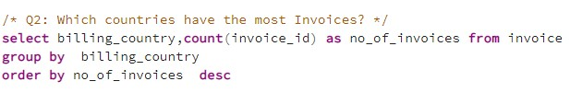
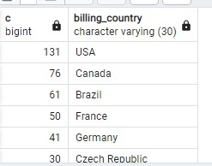
SQL analysis with their output

Slide 4
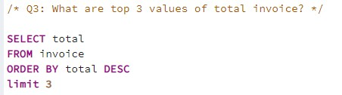
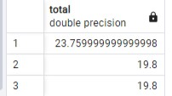
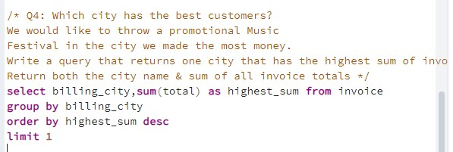


Slide 5
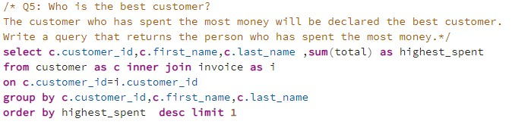

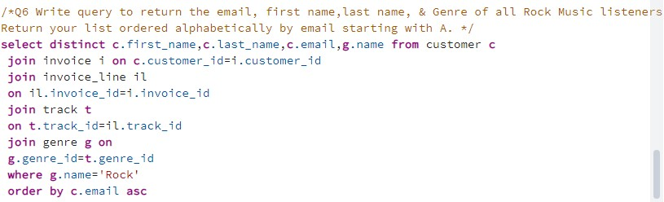

Slide 6
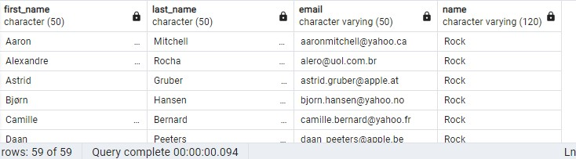
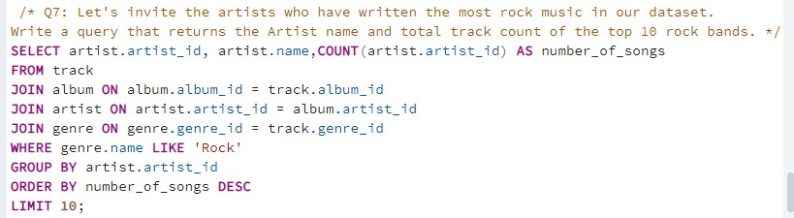
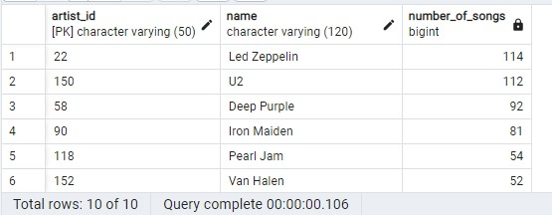

Slide 7
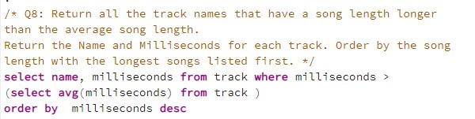
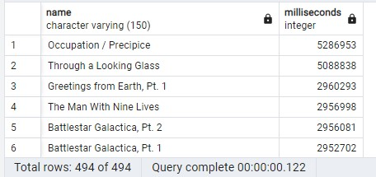

Slide 8
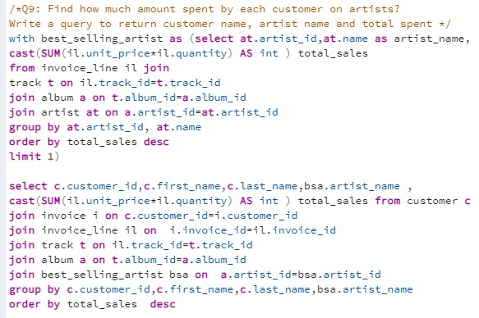
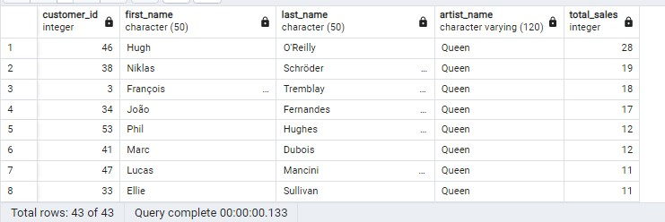

Slide 9
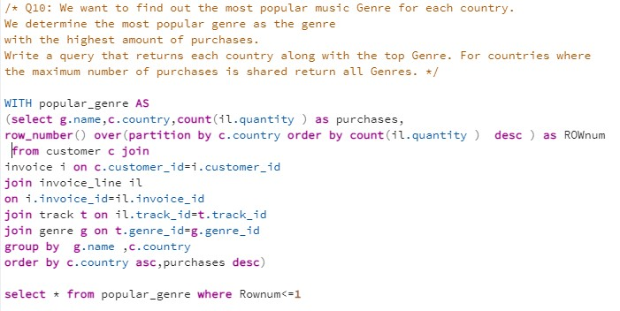
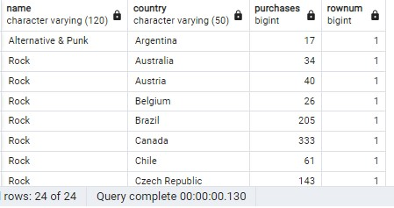

Slide 10
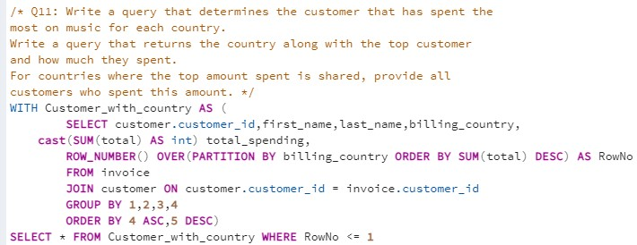
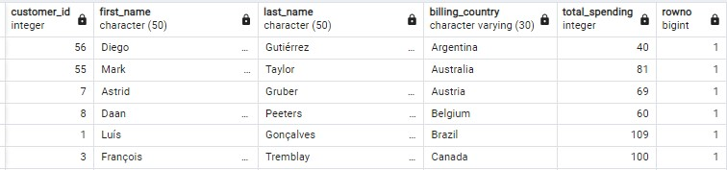

Slide 11
INSIGHTS
Employee Distribution: There are fewer employees at the senior level compared to the junior level.
Customer Countries: The majority of customers, approximately 70%, are from European countries.
Top Revenue Source: The maximum total invoice amount comes from Prague city. Additionally, the top two customers who spend the most money also belong to Prague.
Popular Music Genre: Rock is the only music genre that is popular in all countries except Argentina in terms of purchase.
Leading Rock Artist: Led Zeppelin is the artist who has written the most rock music.

Slide 12
CONCLUSION
The Music Store Data Analysis project using SQL provides an opportunity to extract valuable insights from the music store's database. By leveraging SQL's powerful querying capabilities, we can gain a deeper understanding of customer preferences, sales patterns, inventory management, and financial performance. These insights can guide data-driven decision-making, optimize business strategies, and ultimately enhance the music store's overall operations and profitability.

